Slide 1

Azure Form Recognizer + Terraform

Slide 2
Agenda
Azure Form Recognizer Overview
Architecture
Used Azure Services
Demo
What in the future
Terraform
Infrastructure
Why not ARM template?
Demo
Cognitive Services
Resources
Q&A

Slide 3






Who Am I?
.NET/Azure Architect at Billennium
Traveling, soccer & cycling
maciejskuratowski@gmail.com
mskuratowski.com
@mskuratowski
m.skuratowski

Slide 4
Azure Form Recognizer Overview
cognitive service
machine learning technology to identify and extract key-value pairs and table data from form documents
available as a REST API
two models custom models and prebuilt receipt model
container support

Slide 5
Azure Form Recognizer
Private preview access
To get access to the preview, fill out and submit the Form Recognizer access request form
available only for a few regions
API Documenation: https://westus2.dev.cognitive.microsoft.com/docs/services/form-recognizer-api/operations/AnalyzeWithCustomModel

Slide 6
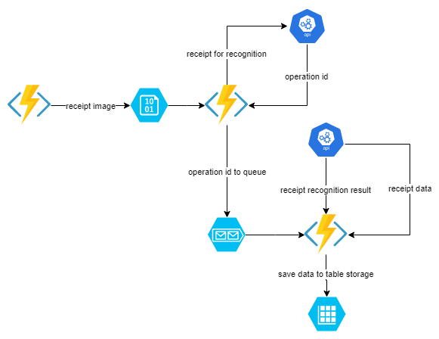

Slide 7





Used Azure Services
Form Recognizer
Azure Functions
Blob Storage
Table Storage
Queue

Slide 8


Slide 9
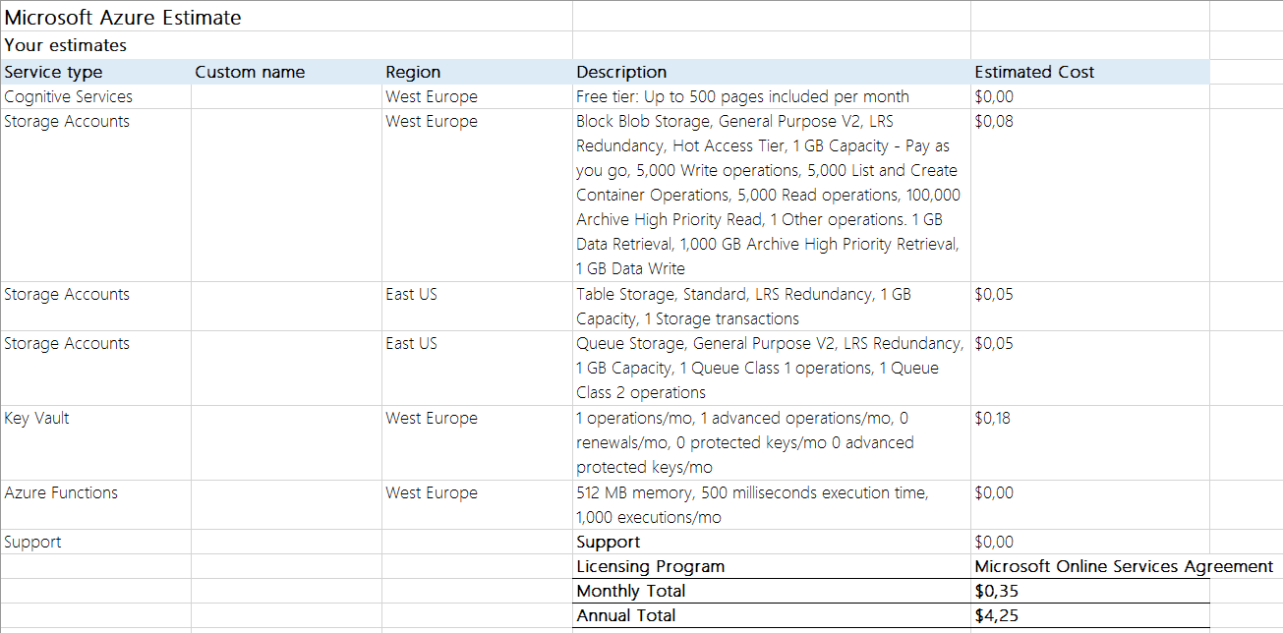

Slide 10
Plans for future
Dedicated SPA
DevOps process for IaC
DevOps process for App
Upgrade to Form Recognizer 2.0 API (it should be soon)

Slide 11
Terraform
Traditional
manual
downtime
people dependent
misconfiguration
not repeatable
Terraform
automated
version controlled
CI/CD
Infrastructure as a Code
repeatable

Slide 12

Terraform
open source
started in 2014
declarative
provider agnostic (e.g. AWS, Azure, GCP etc.)
IaC
Plan before execute
Resource Graph
HCL or JSON

Slide 13
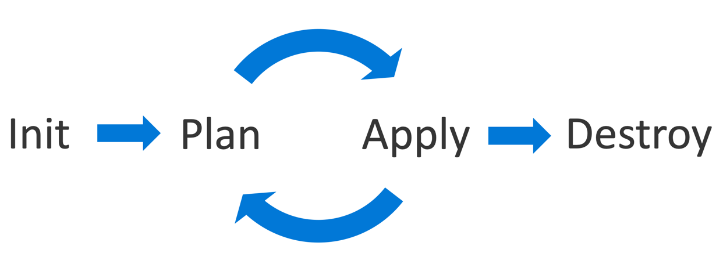

Slide 14
Terraform State
JSON
updated when Terraform runs
refreshed before an operation takes place
backwards compatible between TF versions

Slide 15
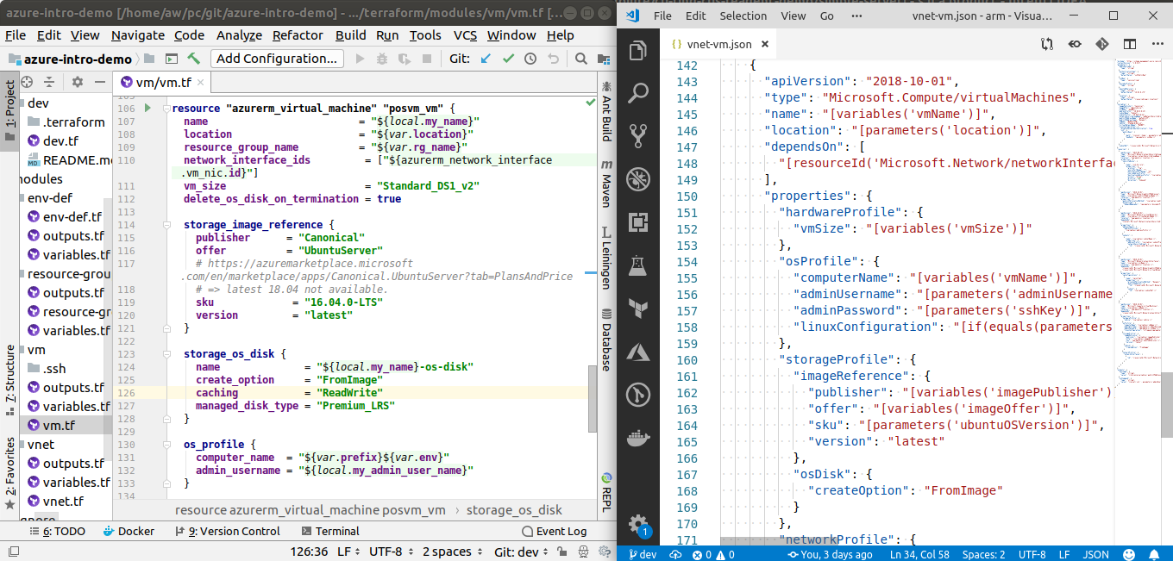

Slide 17
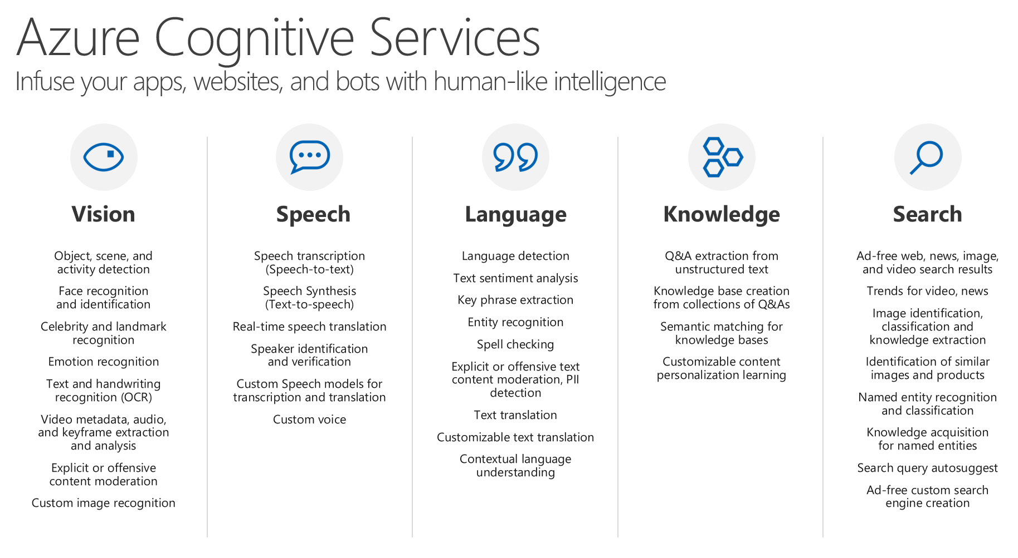
https://azure.microsoft.com/en-us/services/cognitive-services/

Slide 18
Resources
https://azure.microsoft.com/en-us/services/cognitive-services/form-recognizer/
https://westus2.dev.cognitive.microsoft.com/docs/services/form-recognizer-api/operations/AnalyzeWithCustomModel
https://www.terraform.io/
https://learn.hashicorp.com/terraform?track=azurerm#azurerm

Slide 19


Slide 20


